Slide 1

Geometry
Unit 3, Lesson 2 Vertical and Corresponding Angles Volume 1, pg. 132

Slide 2


Benchmark
MA.912.GR.1.1
Prove relationships and theorems about lines and angles. Solve mathematical and real-world problems involving postulates, relationships, and theorems of lines and angles.
volume 1, pg. 132

Slide 3
Integrated Mathematical Thinking and Reasoning Standards
MA.K12.MTR.1.1 Actively participate in effortful learning both individually and collectively.
MA.K12.MTR.4.1 Engage in discussions that reflect on the mathematical thinking of self and others.
MA.K12.MTR.5.1 Use patterns and structure to help understand and connect mathematical concepts.
volume 1, pg. 132

Slide 4

Learning Targets
I can use vertical angles to solve problems.
I can use corresponding angles formed by parallel lines and a transversal to solve problems.
volume 1, pg. 132

Slide 5

Warm-Up
volume 1, pg. 133

Slide 6
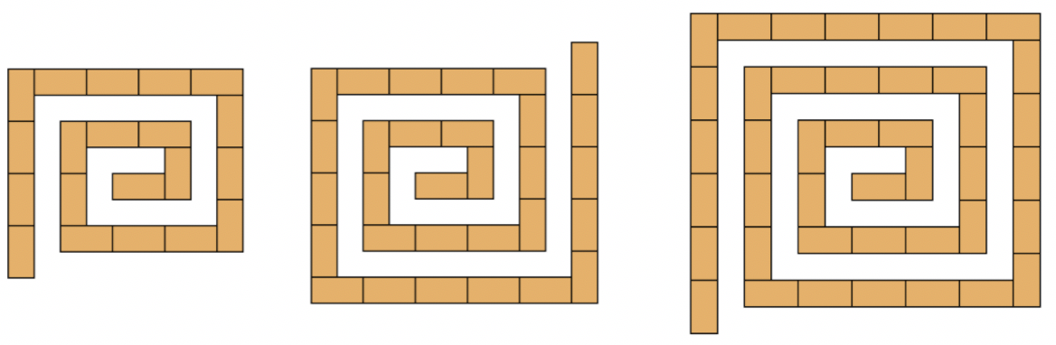
3.2.1 Warm-Up: Shape Sequence
A sequence of three shapes created using rectangles is shown.
How many rectangles will have to be added for the next step in the sequence?
How many rectangles will be in Figure 11?
volume 1, pg. 133

Slide 7

Exploration
volume 1, pg. 133

Slide 8

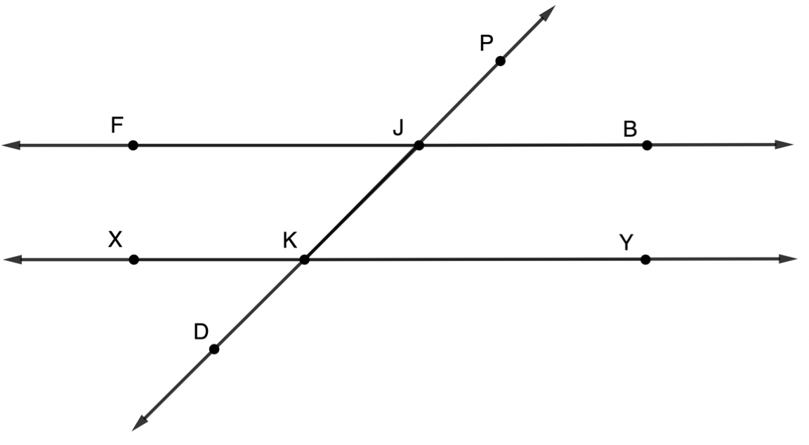
3.2.2 Exploration: Parallel Lines
$\overset{⃡}{FB}$, $\overset{⃡}{XY}$, and $\overset{⃡}{DP}$ are shown, where $\overset{⃡}{DP}$ intersects $\overset{⃡}{FB}$ at point $J$ and where $\overset{⃡}{DP}$ intersects $\overset{⃡}{XY}$ at point $K$.
volume 1, pg. 133

Slide 9
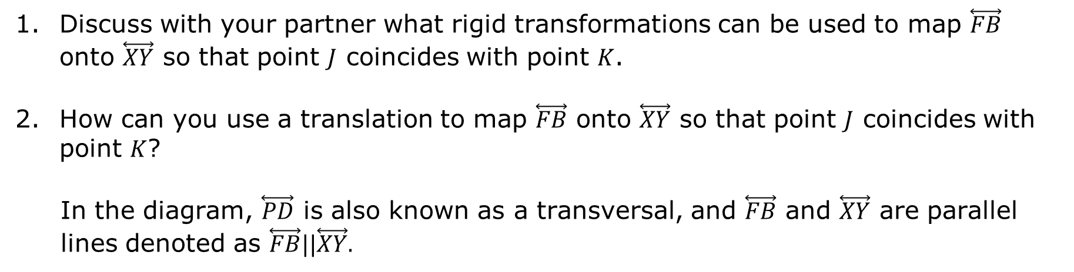
Discuss with your partner what rigid transformations can be used to map $\overset{⃡}{FB}$ onto $\overset{⃡}{XY}$ so that point $J$ coincides with point $K$.
How can you use a translation to map $\overset{⃡}{FB}$ onto $\overset{⃡}{XY}$ so that point $J$ coincides with point $K$?
In the diagram, $\overset{⃡}{PD}$ is also known as a transversal, and $\overset{⃡}{FB}$ and $\overset{⃡}{XY}$ are parallel lines denoted as $\overset{⃡}{FB}||\overset{⃡}{XY}.$
volume 1, pg. 133

Slide 10

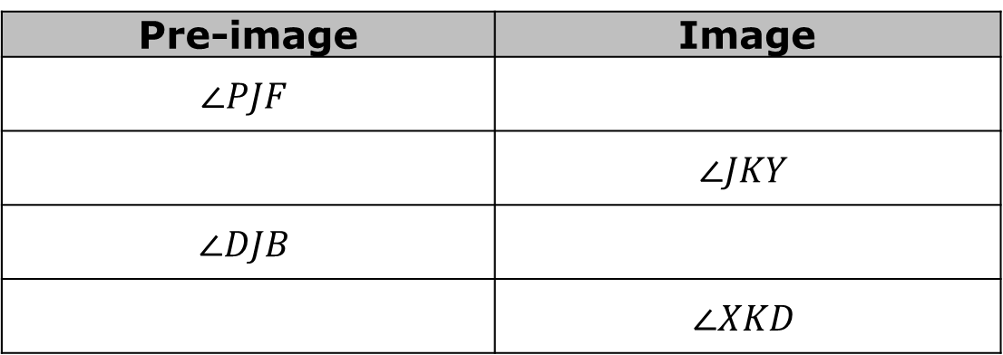
A transversal is a line that intersects two or more lines in the same plane at different points.
Use the translation of $\overset{⃡}{FB}$ onto $\overset{⃡}{XY}$ so that point $J$ coincides with point $K$ to name the new angles in the chart.
Pre-image | Image
$$∠PJF$$
 | $$∠JKY$$
$$∠DJB$$
 | $$∠XKD$$
The angles listed in the table above are corresponding angles.
volume 1, pg. 134

Slide 11
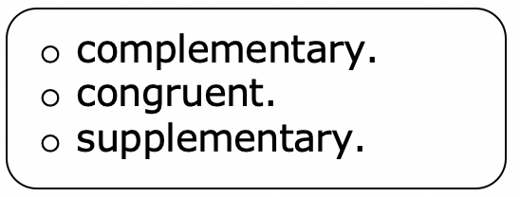
Corresponding angles are angles that are in the same position on two parallel lines in relation to a transversal.
Complete the statement.
Given that corresponding angles of parallel lines can be mapped to each other using rigid transformations, it can
be concluded that the angles are
volume 1, pg. 134

Slide 12
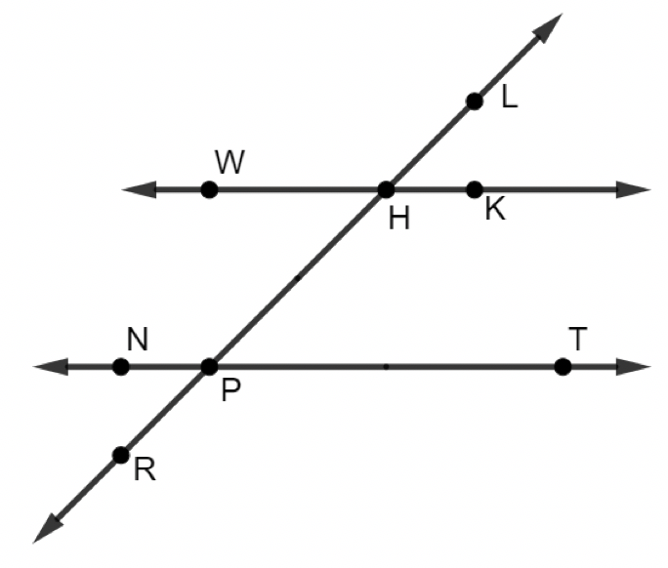
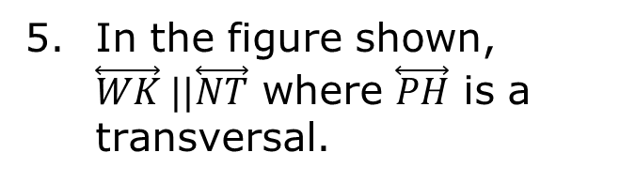
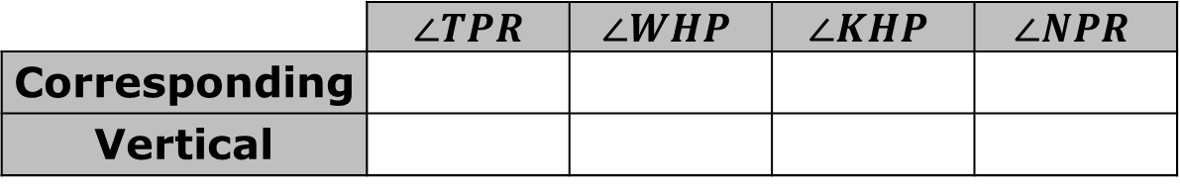
In the figure shown, $\overset{⃡}{WK} ||\overset{⃡}{NT}$ where $\overset{⃡}{PH}$ is a transversal.
For each angle, name a corresponding angle and a vertical angle.
Discuss your answers with your partner and make changes, if necessary.
 | $$∠TPR$$ | $$∠WHP$$ | $$∠KHP$$ | $$∠NPR$$
Corresponding
Vertical
volume 1, pg. 134

Slide 13

Guided Practice
volume 1, pg. 135

Slide 14


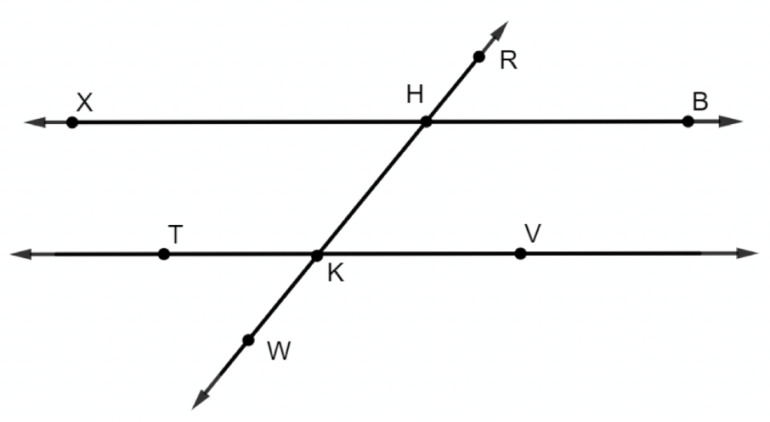
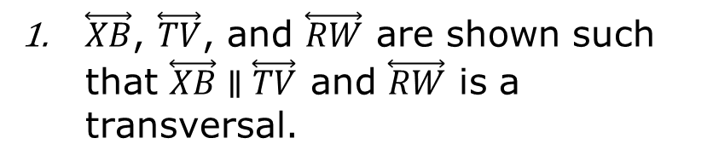
3.2.3 Guided Practice: Angles in Parallel Lines
Corresponding Angles Theorem
If two parallel lines are intersected by a transversal, then corresponding angles are congruent.
$\overset{⃡}{XB}$, $\overset{⃡}{TV}$, and $\overset{⃡}{RW}$ are shown such that $\overset{⃡}{XB}∥\overset{⃡}{TV}$ and $\overset{⃡}{RW}$ is a transversal.
volume 1, pg. 135

Slide 15
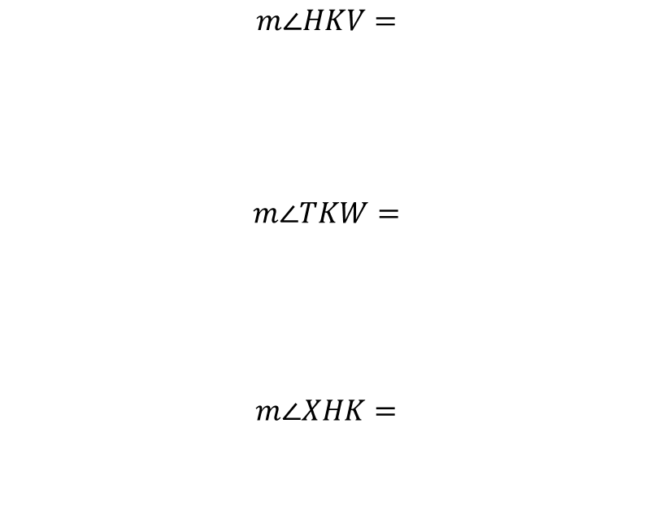
Given $m∠RHB=51°$, determine the measurement of each angle.
$$m∠HKV=$$
$$m∠TKW=$$
$$m∠XHK=$$
volume 1, pg. 135

Slide 16

Describe how to use $m∠RHB=51°$ to find $m∠XHR$.
Explain why knowing $m∠XHR$ allows all of the angles to be determined.
volume 1, pg. 135

Slide 17
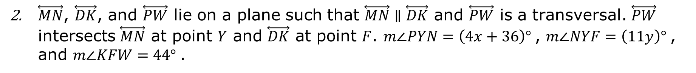
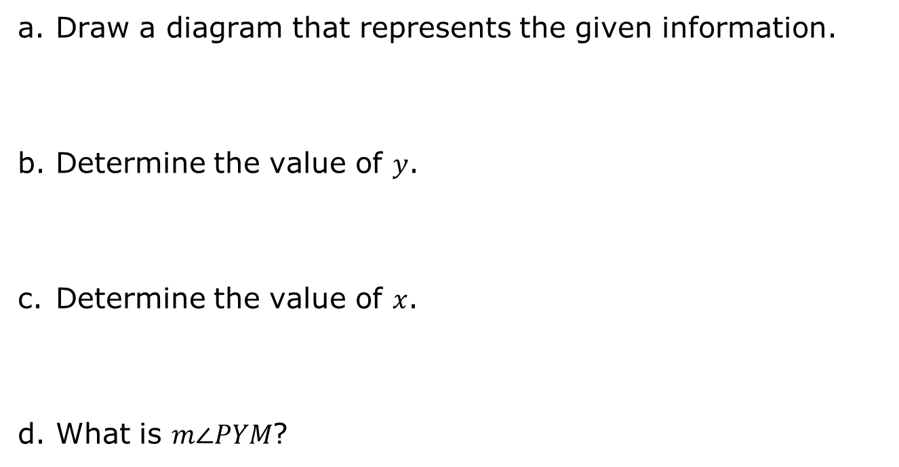
$\overset{⃡}{MN}$, $\overset{⃡}{DK}$, and $\overset{⃡}{PW}$ lie on a plane such that $\overset{⃡}{MN}∥\overset{⃡}{DK}$ and $\overset{⃡}{PW}$ is a transversal. $\overset{⃡}{PW}$ intersects $\overset{⃡}{MN}$ at point $Y$ and $\overset{⃡}{DK}$ at point $F$. $m∠PYN=\left(4x+36\right)°$, $m∠NYF=\left(11y\right)°$, and $m∠KFW=44°$.
Draw a diagram that represents the given information.
Determine the value of $y$.
Determine the value of $x$.
What is $m∠PYM$?
volume 1, pg. 136

Slide 18

Your Turn
volume 1, pg. 136

Slide 19
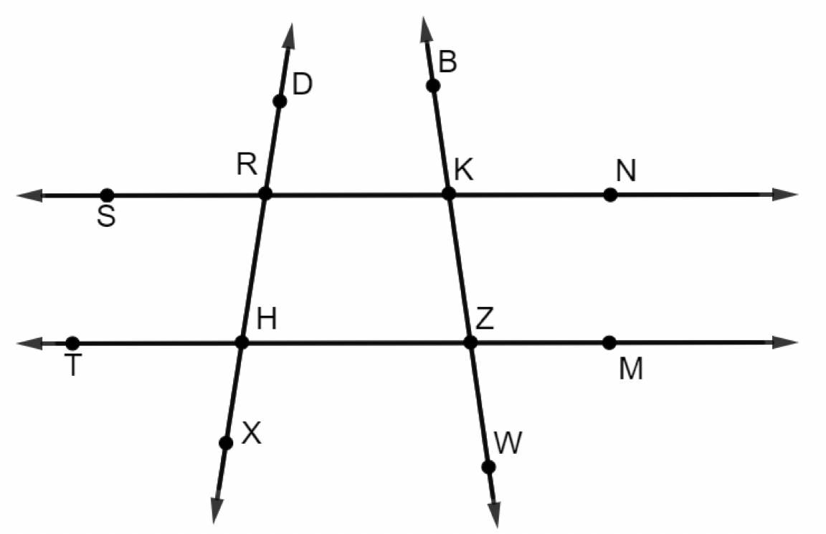
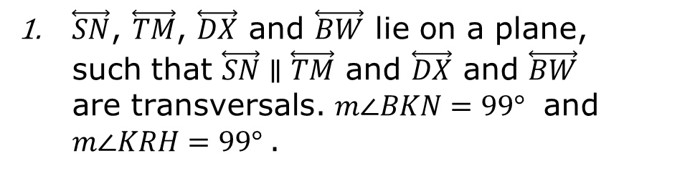
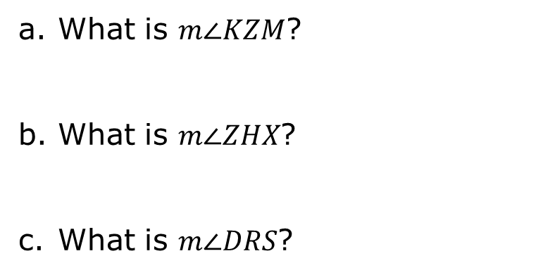
3.2.4 Your Turn!
$\overset{⃡}{SN}$, $\overset{⃡}{TM}$, $\overset{⃡}{DX}$ and $\overset{⃡}{BW}$ lie on a plane, such that $\overset{⃡}{SN}∥\overset{⃡}{TM}$ and $\overset{⃡}{DX}$ and $\overset{⃡}{BW}$ are transversals. $m∠BKN=99°$ and $m∠KRH=99°$.
What is $m∠KZM$?
What is $m∠ZHX$?
What is $m∠DRS$?
volume 1, pg. 136

Slide 20
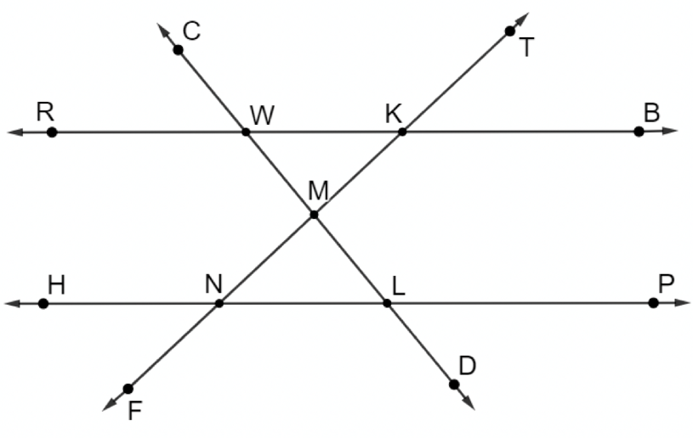
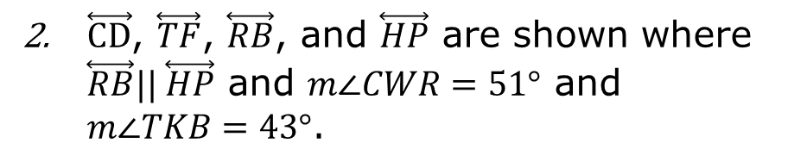
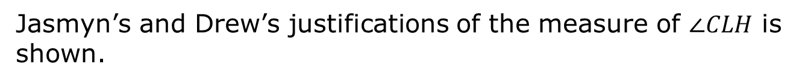
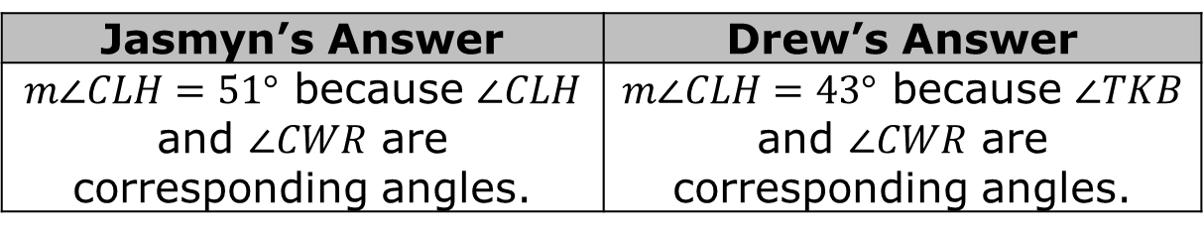
$\overset{⃡}{CD}$, $\overset{⃡}{TF}$, $\overset{⃡}{RB}$, and $\overset{⃡}{HP}$ are shown where $\overset{⃡}{RB}|| \overset{⃡}{HP}$ and $m∠CWR=51°$ and $m∠TKB=43°$.
Jasmyn’s and Drew’s justifications of the measure of $∠CLH$ is shown.
Jasmyn’s Answer | Drew’s Answer
$m∠CLH=51°$ because $∠CLH$ and $∠CWR$ are corresponding angles. | $m∠CLH=43°$ because $∠TKB$ and $∠CWR$ are corresponding angles.
Explain which student you agree with, including your reasoning.
volume 1, pg. 137

Slide 21

Find the measure of the following angles.
$m∠KNL=$ ____________
$m∠HNF=$ ____________
$m∠MLN=$ ____________
volume 1, pg. 137

Slide 22

Wrap-Up
volume 1, pg. 138

Slide 23
3.2.5 Wrap-Up: Cool Down
Draw an example of vertical angles.
Draw an example of corresponding angles.
volume 1, pg. 138

